Slide 1
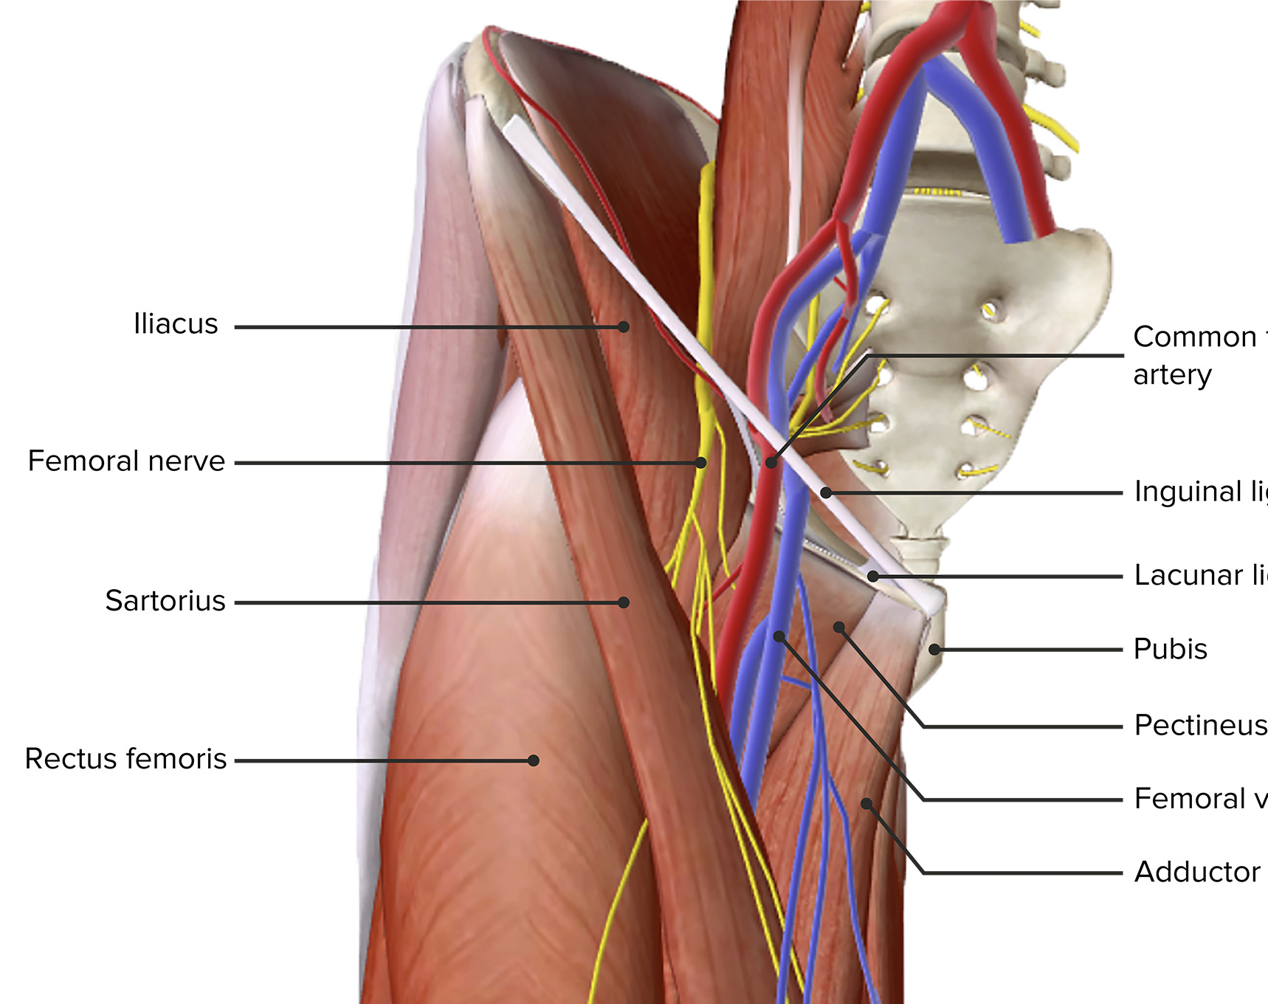
Muscles and Neurovascular Structures around the Hip
Ngozi Onuegbu PhD
PT4050/PT7001

Slide 2
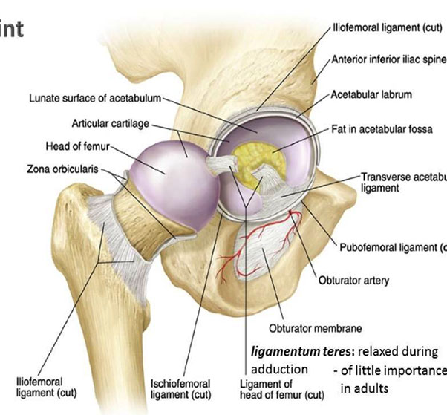
Hip Joint
Type of joint: Ball-and-socket
Articulating surfaces: Acetabulum of the pelvis and head of the femur
Functions: Weight-bearing, locomotion, stability, and flexibility
Notes:
What

Slide 3
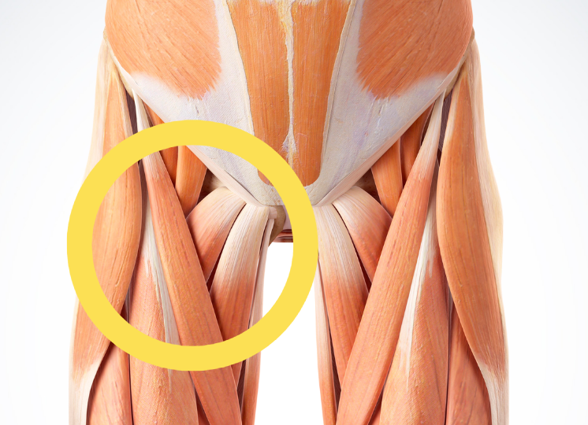
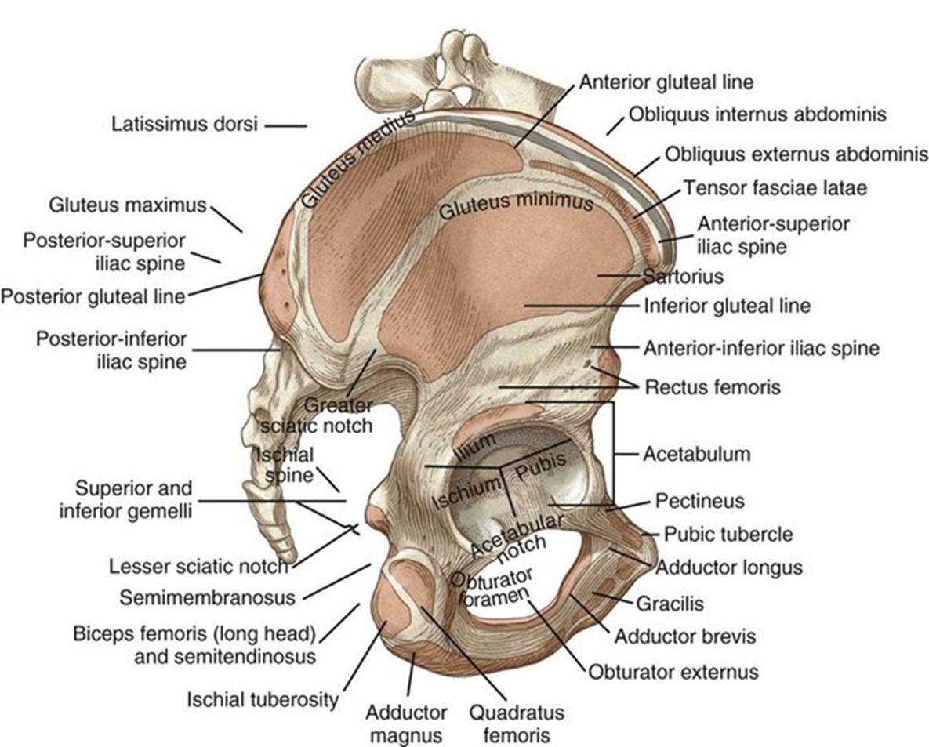
Muscles of the Hip
Flexors: Iliopsoas, Sartorius, Rectus Femoris
Extensors: Gluteus Maximus, Hamstrings
Abductors: Gluteus Medius, Gluteus Minimus, Tensor Fascia Latae
Adductors: Adductor Longus, Adductor Brevis, Adductor Magnus, Gracilis, Pectineus
Internal Rotators: Gluteus Medius (anterior fibers), Gluteus Minimus
External Rotators: Piriformis, Obturator Internus, Obturator Externus, Gemelli, Quadratus Femoris

Slide 4
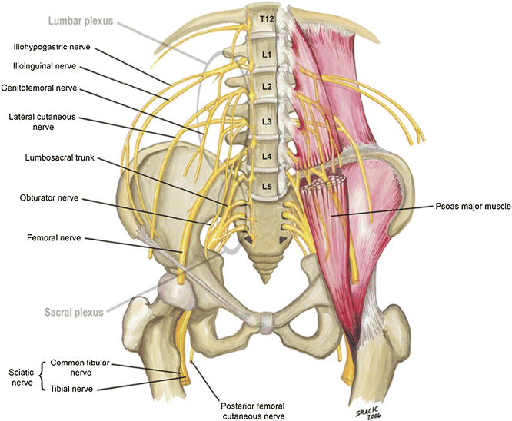
Neurovascular Structures of the Hip
Main Nerves
Femoral Nerve: Innervates anterior muscles (flexors)
Sciatic Nerve: Passes through the gluteal region, innervates posterior compartment (extensors)
Obturator Nerve: Supplies adductor muscles
Gluteal Nerves: Superior (supplies gluteus medius, minimus), Inferior (supplies gluteus maximus)

Slide 5
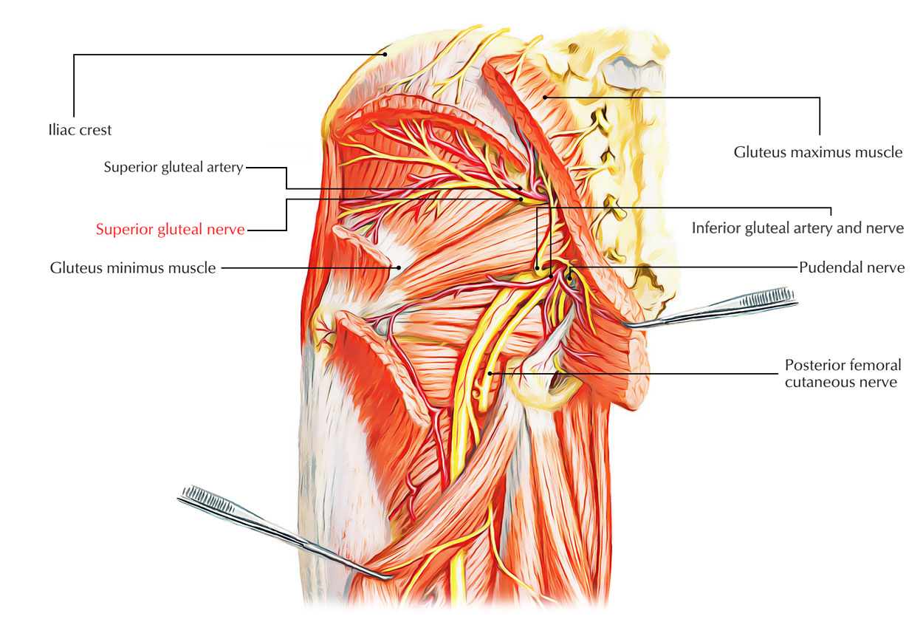
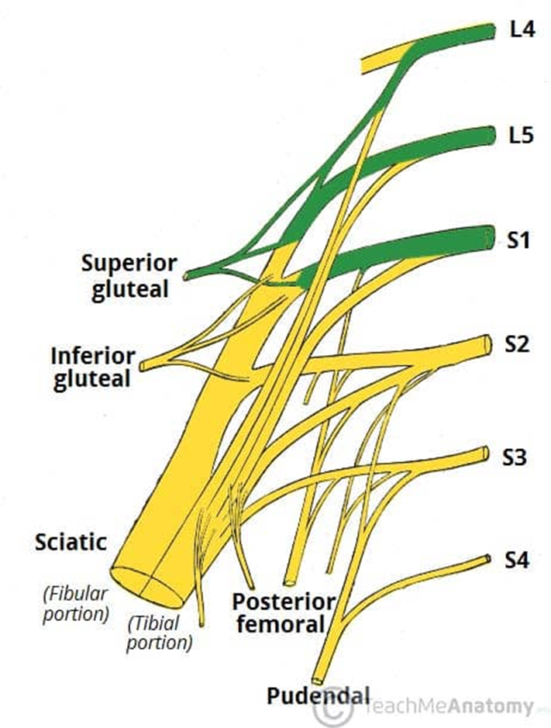
Clinical Relevance: Compression or injury to the sciatic nerve may cause sciatica, and damage to the superior gluteal nerve may result in weakened hip abduction, contributing to gait abnormalities.
Gluteal Nerves

Slide 6
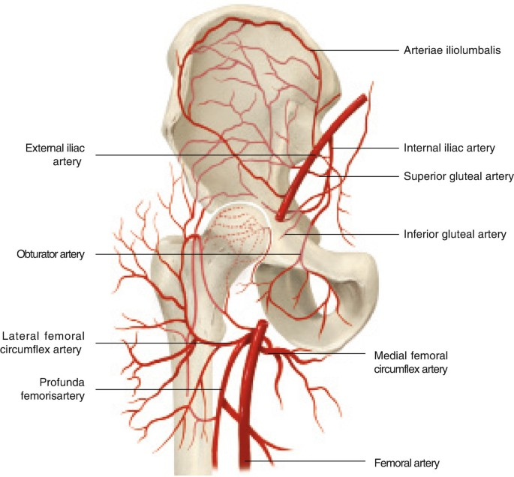
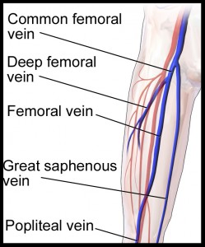
Neurovascular Structures of the Hip
Blood Supply
Arteries: Femoral artery, obturator artery, superior and inferior gluteal arteries
Veins: Femoral vein, great saphenous vein

Slide 7
Anterior Muscles (Hip Flexors)

Slide 8
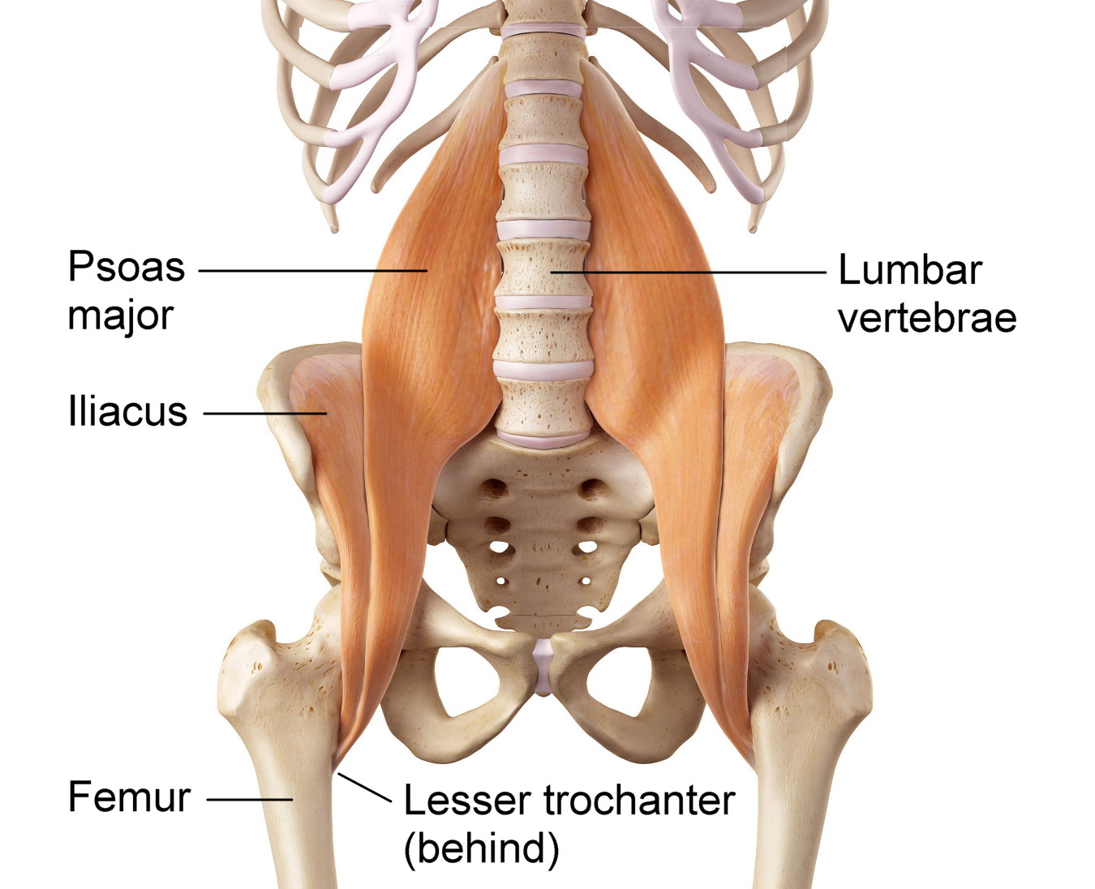
Iliopsoas Muscle
Origin:
  Psoas major: Transverse processes of T12-L5 vertebrae
  Iliacus: Iliac fossa of pelvis
Insertion:
  Lesser trochanter of femur
Action:
  Hip flexion
Nerve supply:
  Femoral nerve (L2-L4)
Blood supply:
  Iliolumbar artery, femoral artery
Clinical Relevance:
  Tightness in the iliopsoas is common in individuals with prolonged sitting postures and can contribute to lower back pain and anterior pelvic tilt.

Slide 9
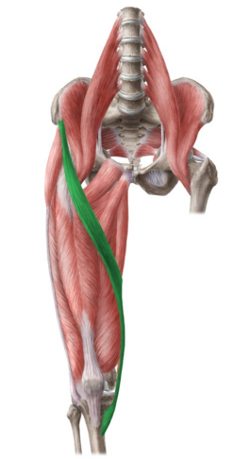
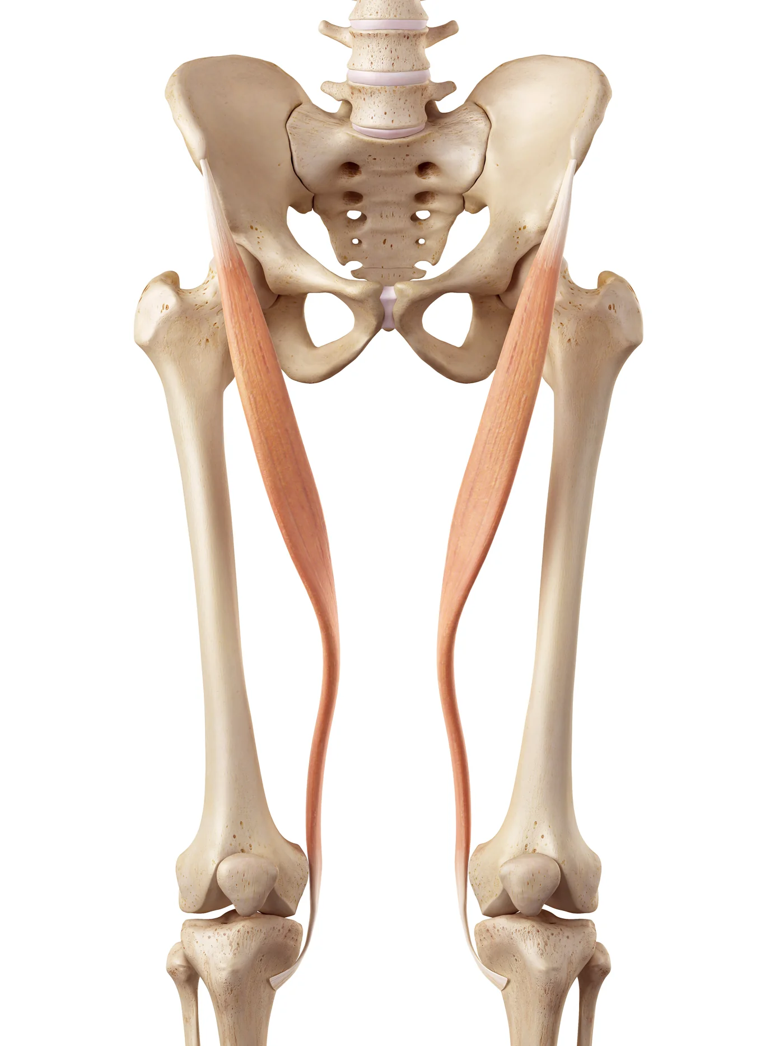
Sartorius
Origin:
  Anterior superior iliac spine (ASIS)
Insertion:
  Pes anserinus (medial surface of tibia)
Action:
  Flexes, abducts, and externally rotates the hip; flexes the knee
Nerve supply:
  Femoral nerve (L2-L3)
Blood supply:
  Femoral artery
Clinical Relevance:
  Pes anserine bursitis, commonly seen in runners, can affect the insertion point of the sartorius along with other muscles in the region.

Slide 10
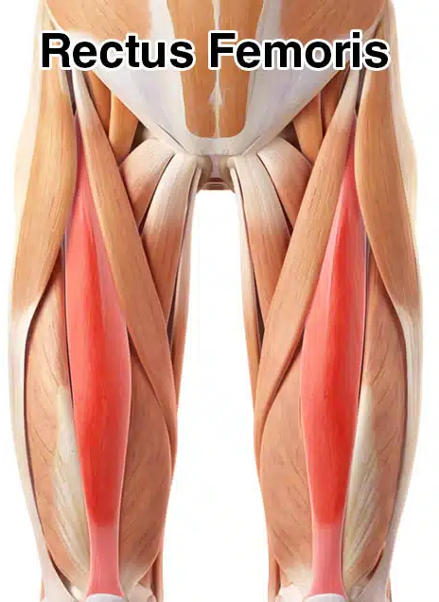
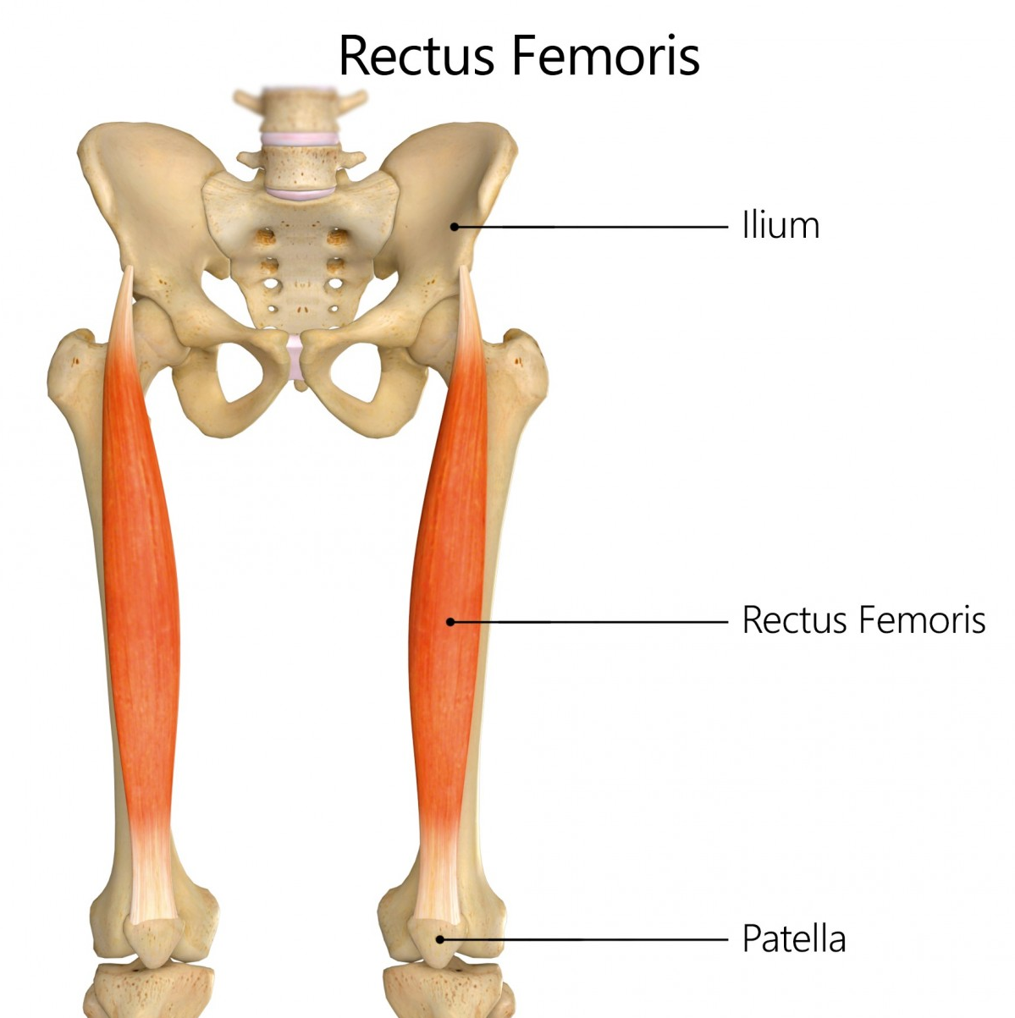
Rectus Femoris (Part of Quadriceps)
Origin:
  Anterior inferior iliac spine (AIIS) and superior part of the acetabulum
Insertion:
  Tibial tuberosity (via patellar ligament)
Action:
  Hip flexion, knee extension
Nerve supply:
  Femoral nerve (L2-L4)
Blood supply:
  Lateral circumflex femoral artery
Clinical Relevance:
  Rectus femoris strain is common in sports involving kicking or sudden acceleration, causing pain in the anterior thigh.

Slide 11
Posterior Muscles (Hip Extensors)

Slide 12
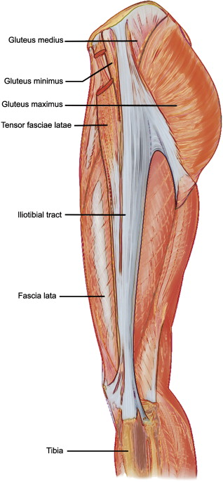
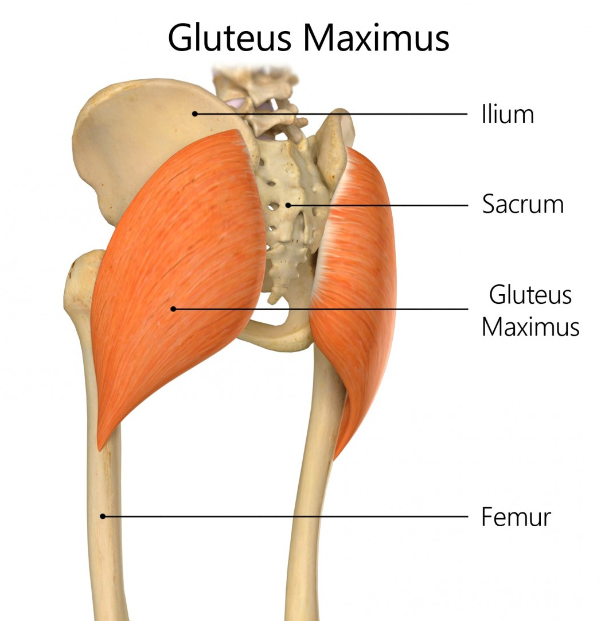
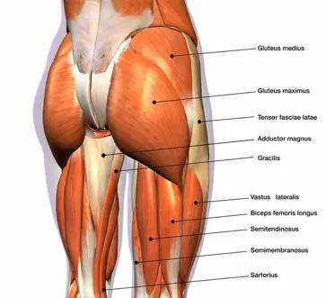
Gluteus Maximus
Origin:
  Ilium, sacrum, coccyx, and sacrotuberous ligament
Insertion:
  Gluteal tuberosity of femur and iliotibial tract
Action:
  Hip extension, external rotation
Nerve supply:
  Inferior gluteal nerve (L5-S2)
Blood supply:
  Inferior and superior gluteal arteries
Clinical Relevance:
  Weakness in the gluteus maximus can contribute to conditions such as lower back pain and hip instability. This muscle is often targeted in rehabilitation for patients with weak hip extensors.

Slide 13
Lateral Muscles (Hip Abductors and Rotators)

Slide 14
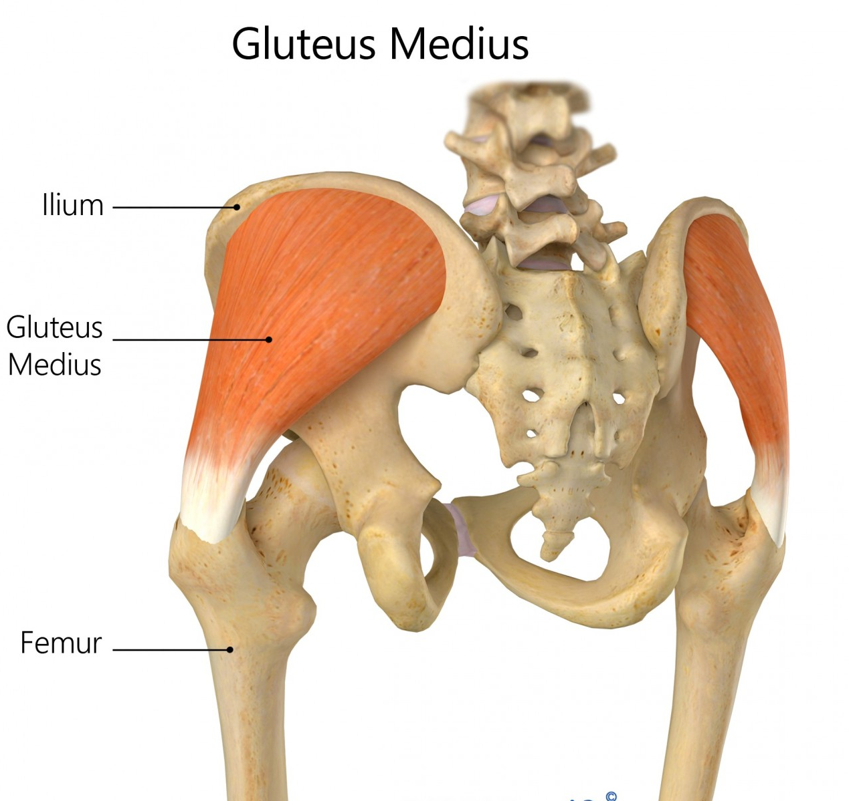
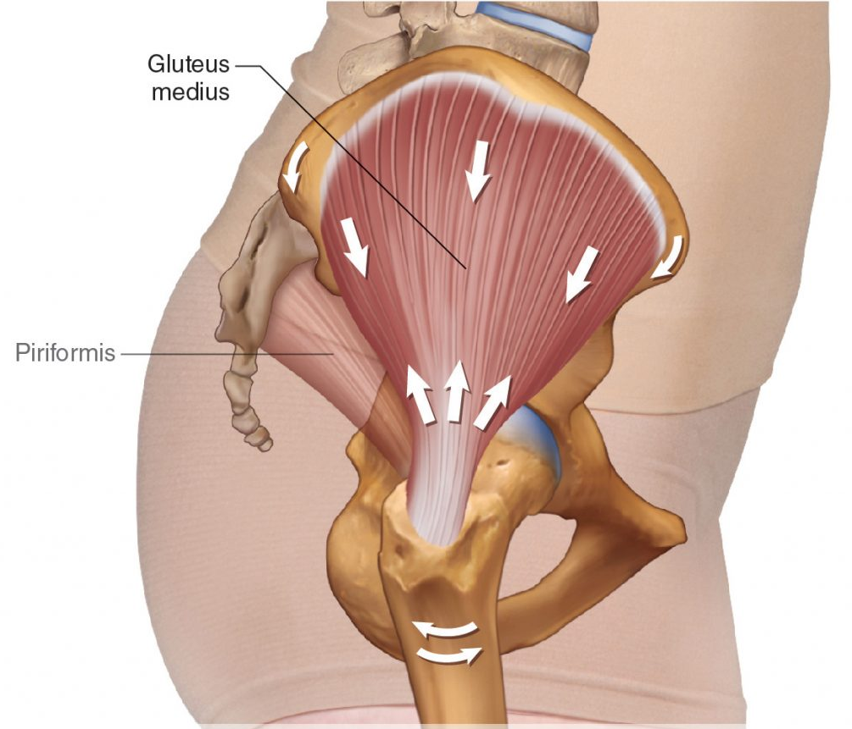
Gluteus Medius
Origin:
  Outer surface of ilium
Insertion:
  Greater trochanter of femur
Action:
  Hip abduction and internal rotation
Nerve supply:
  Superior gluteal nerve (L4-S1)
Blood supply:
  Superior gluteal artery
Clinical Relevance:
  Gluteus medius weakness can lead to "Trendelenburg gait," a lateral pelvic drop during walking. It's commonly addressed in hip strengthening exercises.

Slide 15
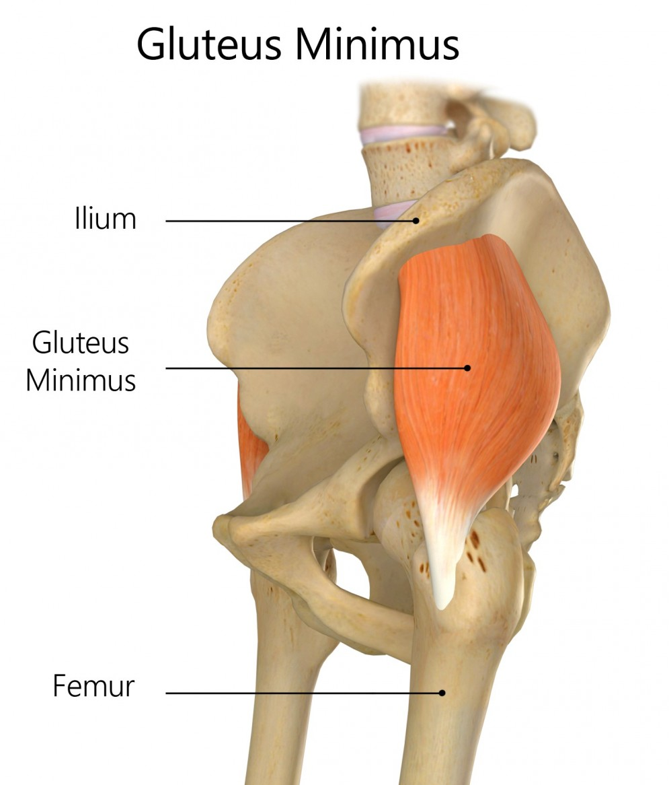
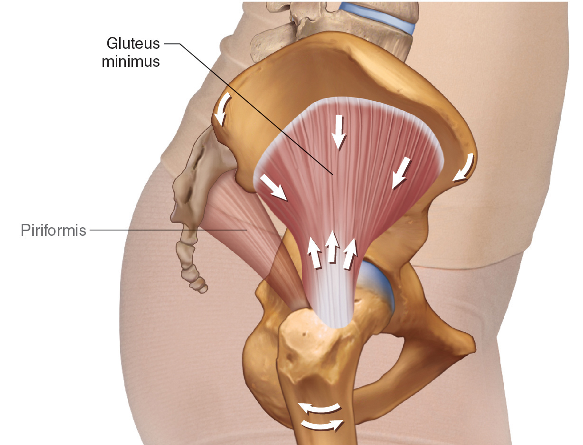
Gluteus Minimus
Origin:
  Outer surface of ilium (below gluteus medius)
Insertion:
  Greater trochanter of femur
Action:
  Hip abduction, internal rotation
Nerve supply:
  Superior gluteal nerve (L4-S1)
Blood supply:
  Superior gluteal artery
Clinical Relevance:
  Gluteus minimus strain or injury may result in referred pain to the hip and buttock area, often mistaken for sciatica.

Slide 16
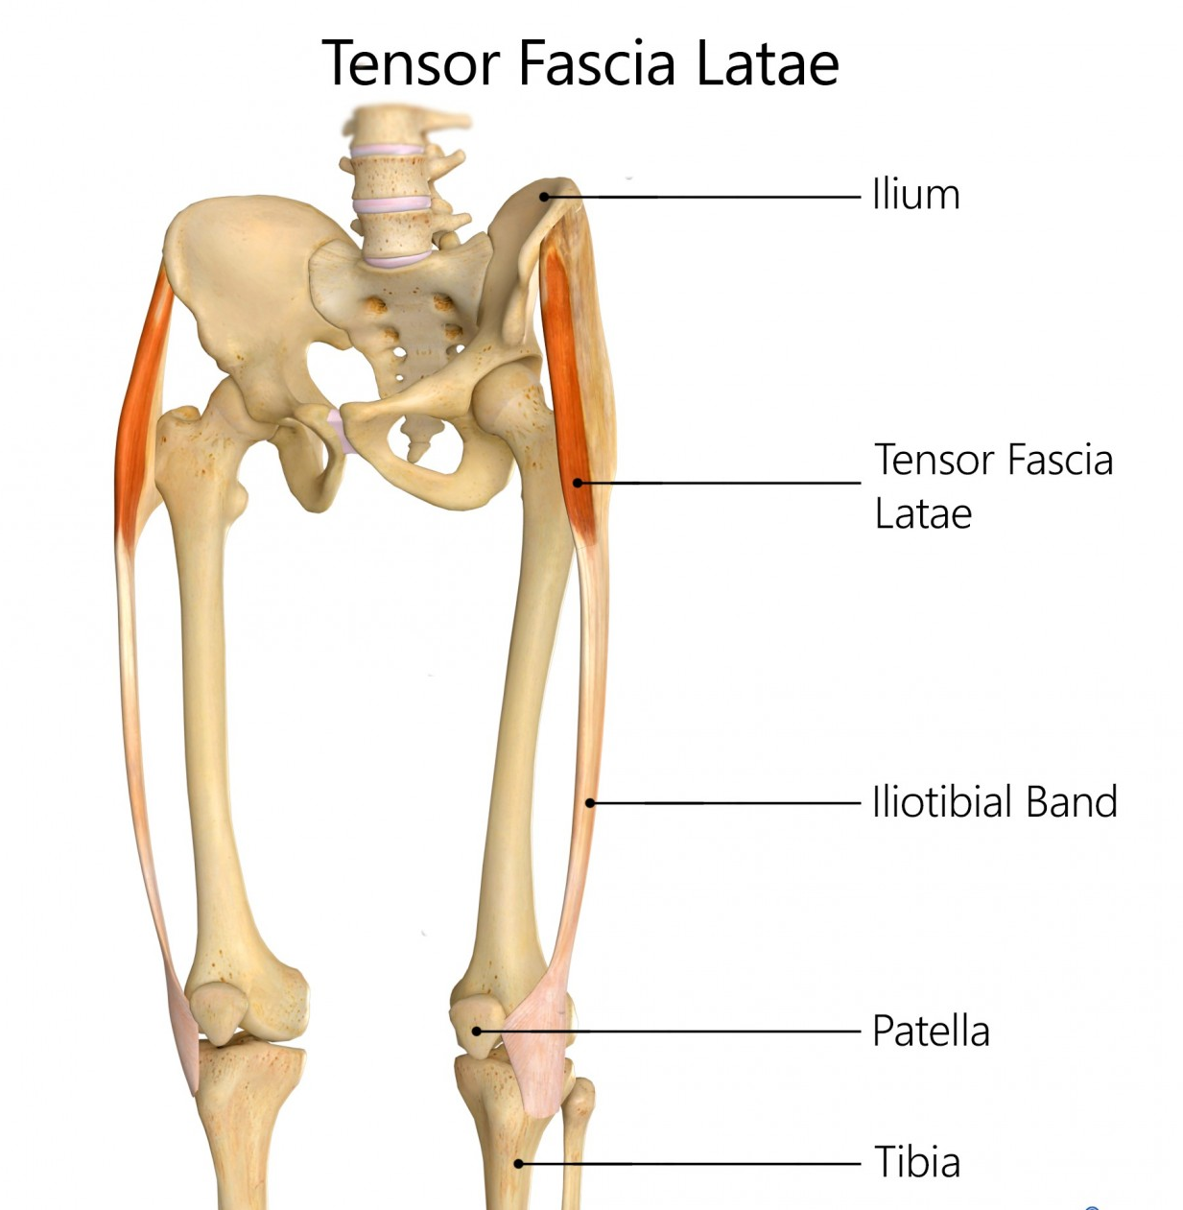
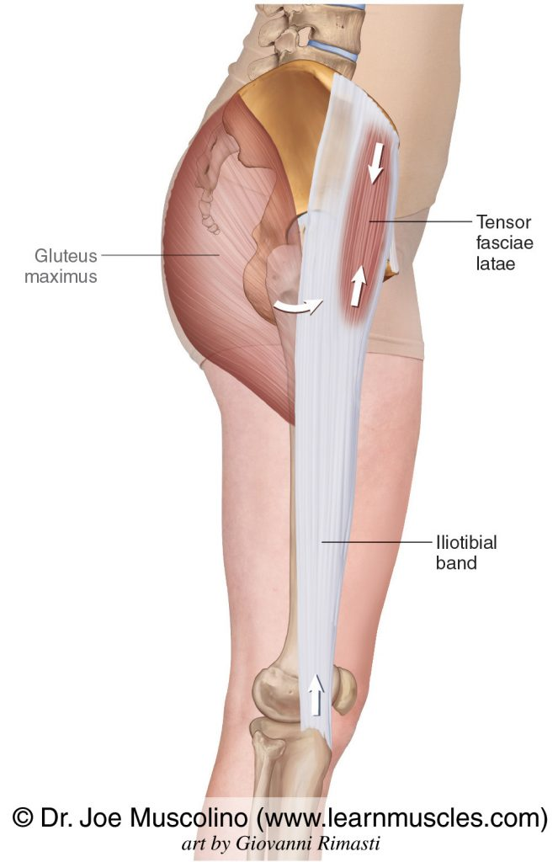
Tensor Fascia Latae
Origin:
  Anterior iliac crest
Insertion:
  Iliotibial tract/band
Action:
  Assists with hip flexion, abduction,
  and internal rotation
Nerve supply:
  Superior gluteal nerve (L4-S1)
Blood supply:
  Lateral circumflex femoral artery
Clinical Relevance:
  Tightness in the tensor fascia latae (TFL) can contribute to iliotibial band (ITB) syndrome, common in runners and cyclists, causing lateral knee pain.

Slide 17
Medial Muscles (Hip Adductors)

Slide 18
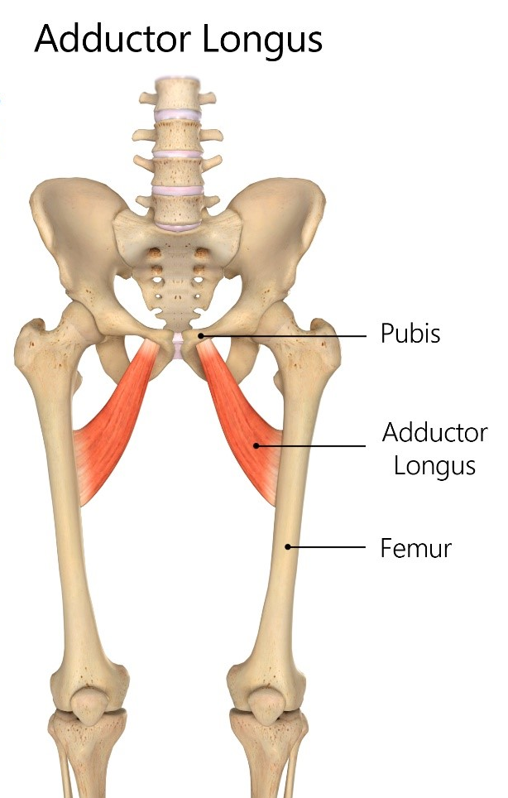
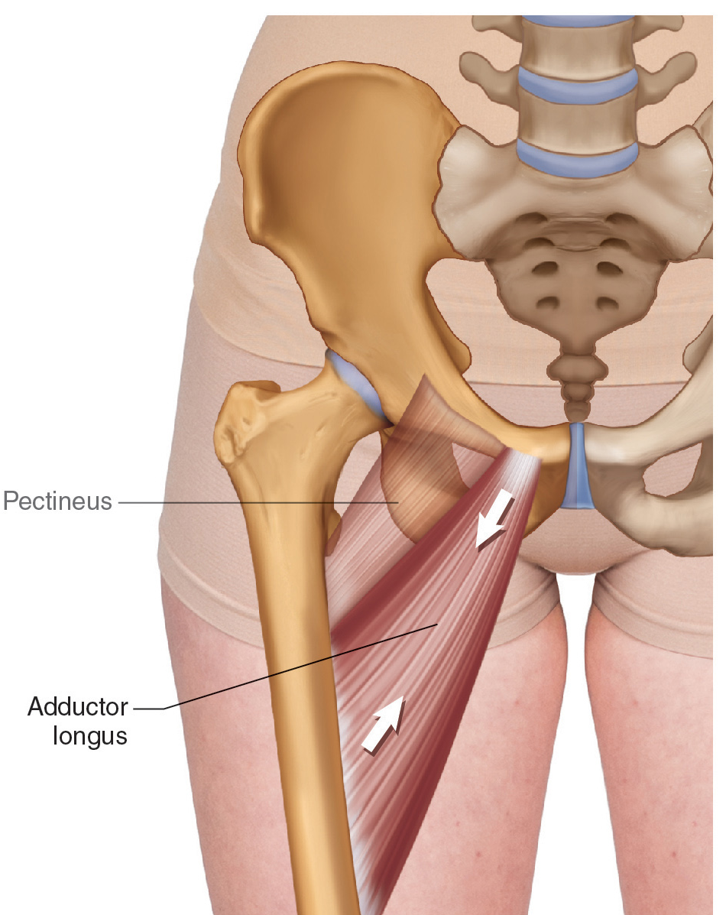
Adductor Longus
Origin:
  Pubis (near pubic symphysis)
Insertion:
  Middle third of linea aspera of femur
Action:
  Hip adduction, assists in flexion
Nerve supply:
  Obturator nerve (L2-L4)
Blood supply:
  Deep femoral artery
Clinical Relevance:
  Adductor strains, often called "groin pulls," are common in sports requiring rapid direction changes or side movements (e.g., soccer, hockey).

Slide 19
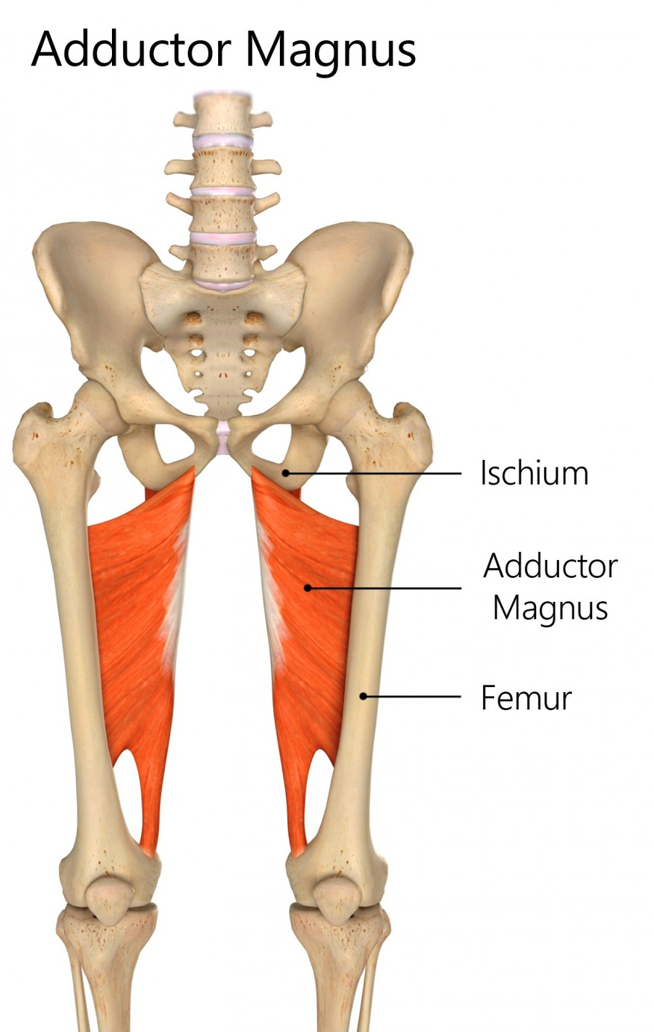
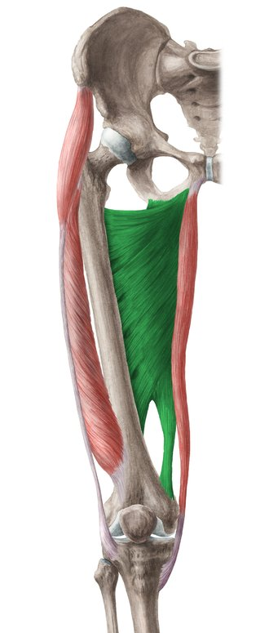
Adductor Magnus
Origin:
  Ischial tuberosity and inferior pubic ramus
Insertion:
  Linea aspera and adductor tubercle of femur
Action:
  Hip adduction, flexion (adductor part), extension (hamstring part)
Nerve supply:
  Obturator nerve (adductor part), sciatic nerve (hamstring part) (L2-S1)
Blood supply:
  Deep femoral artery
Clinical Relevance:
  Adductor magnus can be involved in hip joint pathologies such as osteitis pubis, characterized by inflammation of the pubic symphysis.

Slide 20
Hip External Rotators

Slide 21
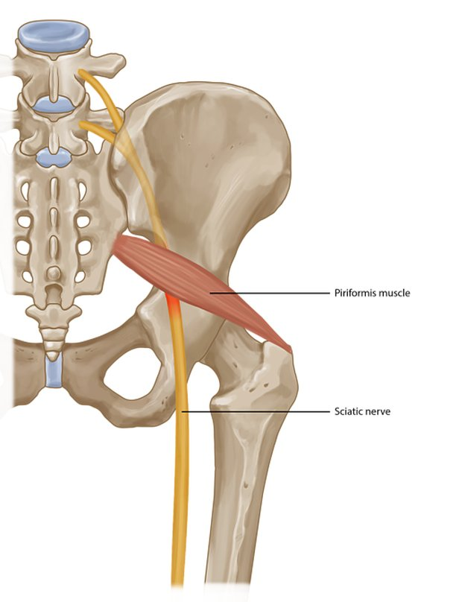
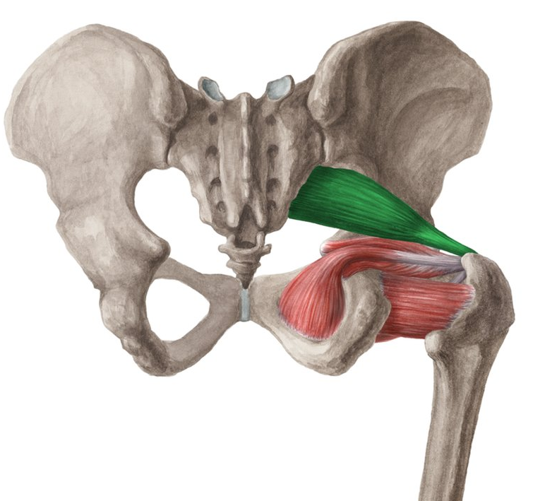
Piriformis
Origin:
  Anterior surface of the sacrum
Insertion:
  Greater trochanter of femur
Action:
  External rotation of the hip
Nerve supply:
  Nerve to piriformis (S1-S2)
Blood supply:
  Superior and inferior gluteal arteries
Clinical Relevance:
  Piriformis syndrome occurs when the piriformis muscle compresses the sciatic nerve, causing sciatica-like symptoms such as buttock pain radiating down the leg.

Slide 22
Common Conditions and Injuries
Hip fractures
Osteoarthritis
Sciatica and Piriformis syndrome
Hip labral tears
Tendinopathies (e.g., gluteal tendinopathy)

Slide 23
SDL
Read up on the root, course, branches, function, and clinical anatomy of the Sciatic nerve
Read up on the root, course, branches, function, and clinical anatomy of the Femoral nerve

Slide 24

Questions?

Slide 25
References
Kenhub (n.d.) Hip Anatomy and Knee Anatomy Diagrams. Available at: https://www.kenhub.com (Accessed: 14 September 2024).
McMinn, R.M.H. (2019) Last’s Anatomy: Regional and Applied. 13th edn. Elsevier Health Sciences.
Moore, K.L., Dalley, A.F. and Agur, A.M.R. (2018) Clinically Oriented Anatomy. 8th edn. Wolters Kluwer.
Muscolino, J.E. (n.d.) The Muscular System Manual: The Skeletal Muscles of the Human Body. Available at: https://www.learnmuscles.com (Accessed: 14 September 2024).
Netter, F.H. (2019) Atlas of Human Anatomy. 7th edn. Elsevier.Physiopedia (n.d.) Hip and Knee Anatomy Overview. Available at: https://www.physio-pedia.com (Accessed: 14 September 2024).
Rehab My Patient (n.d.) Anatomy of the Hip and Knee. Available at: https://www.rehabmypatient.com (Accessed: 14 September 2024).
Standring, S. (2020) Gray’s Anatomy: The Anatomical Basis of Clinical Practice. 42nd edn. Elsevier.

